Slide 1
IMAGE PROCESSING PROJECT
Lane Detection System
Project by:
Bommisetty Vamsi sai (19bce1076)
Kanakala Tarun Kumar (19bce1284)
Chithirala naga chandan (19bce1604)

Slide 2
ABSTRACT
Many road accidents occur nowadays due to negligence of driving rules by drivers which includes lane shifting.
Lane shifting should be done by following certain traffic rules. Improper lane shifting leads to accidents.
Our project detects the lanes present in the video/image using OpenCv.
We are going to achieve this goal by a well-known method of line detection named Hough probabilistic transform.
Before Hough transform in this study, we are using gray scale image, camera calibration, masking filter as preprocessing techniques and letter on, Canny edge detection as a method of edge detection.
We firstly implement our method on image and then we will continue our work on video which is a more realistic case study, and we will show our detection with a red line on the screen

Slide 3
INTRODUCTION
In the past decade, scientist have tried to purpose the Advanced Driver Assistant Systems (ADAS) for autonomous vehicles to help driving be a safer and more fun task to do.
As a basic approach, ADAS is using cameras placed on the forehead of the car to collect images and videos for autonomous driving
Firstly, we get help from grayscale and blurring to perform some preprocessing on our image, after that, we implement mask filtering to focus on the area of interest.
Furthermore, we implement Canny edge detection on our image to detect our mane edges which consist of our lane.
Then, we perform Hough line transform as our main operator and we will paint our lines into an empty image.
At the end, we will show our lanes on the original image with red color. After this process, we will perform the same method on the video which is more realistic

Slide 4
Algorithms
Pre-process image using grayscale and gaussian blur
Canny edge detection
Hough transform

Slide 5
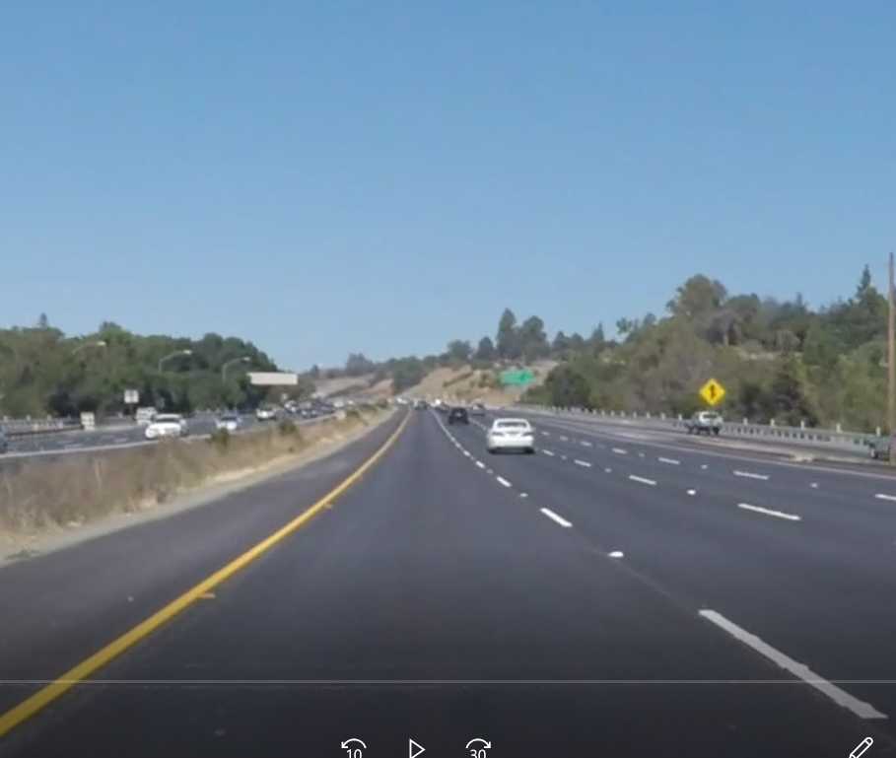
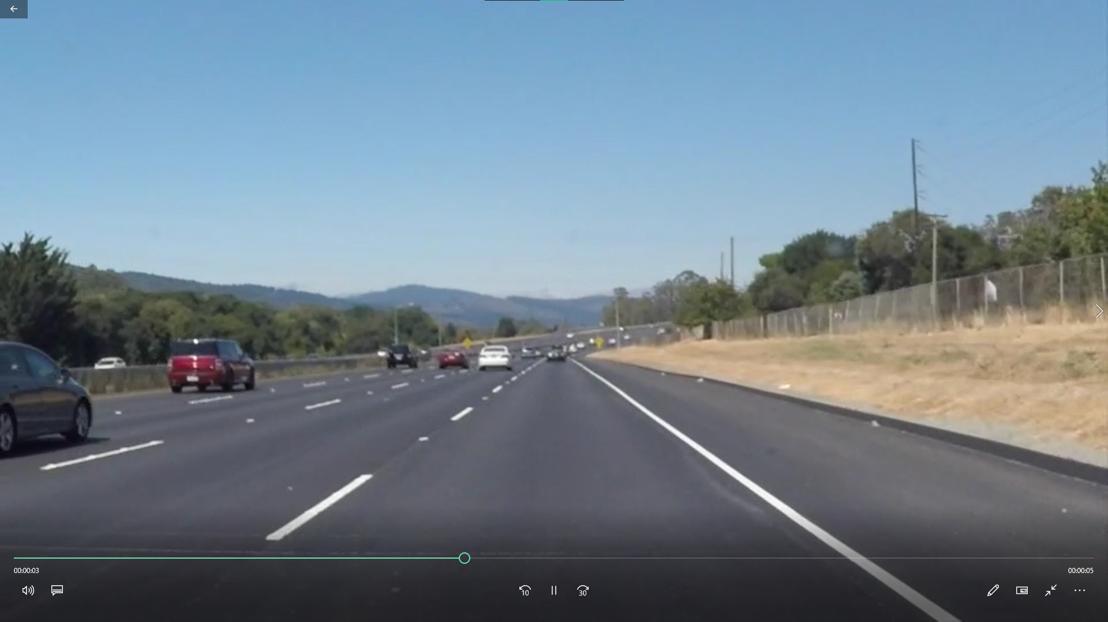
SAMPLE INPUT IMAGES

Slide 6
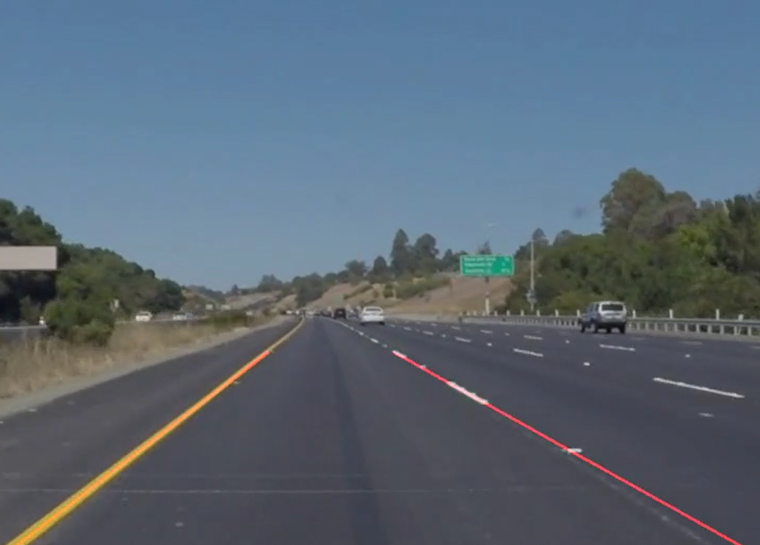
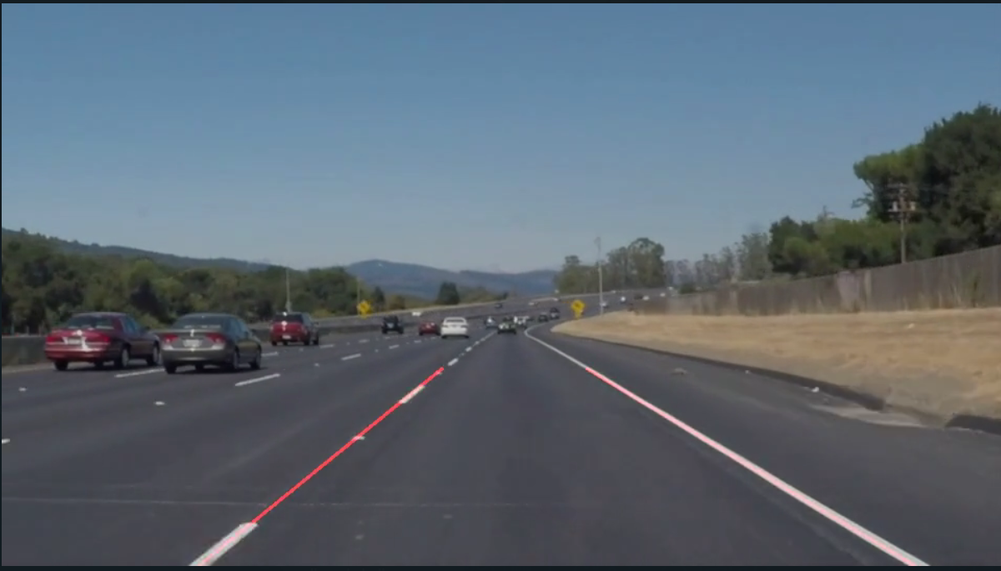
SAMPLE OUTPUT IMAGES

Slide 7
RESEARCH PAPERS REFERRED
https://www.researchgate.net/publication/352550561_Road_lane_detection_through_image_and_video_processing_using_edge_detection_and_Hough_transform_for_autonomous_driving_purposes/link/60cee53192851ca3acb2e74d/download
https://static-01.hindawi.com/articles/am/volume-2018/8320207/figures/8320207.fig.0021.svgz
https://towardsdatascience.com/a-deep-dive-into-lane-detection-with-hough-transform-8f90fdd1322f
https://towardsdatascience.com/a-deep-dive-into-lane-detection-with-hough-transform-8f90fdd1322f

Slide 8
THANK YOU

